Slide 1
Canonical and Standard form

Slide 2
Contents
Complement of Boolean function
HDL Description of Boolean Function
Canonical form representation of Boolean Functions
Standard form representation of Boolean Functions

Slide 3
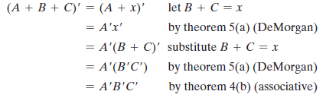
Complement of Boolean function
The complement of a function F is F’ and is obtained from an interchange of 0’s for 1’s and 1’s for 0’s in the value of F.
The complement of a function may be derived algebraically through DeMorgan’s theorems.
DeMorgan’s theorems can be extended to three or more variables.

Slide 4

Complement of Boolean function
DeMorgan’s theorems for any number of variables resemble the two‐variable case in
form and can be derived by successive substitutions similar to the method used in the
preceding derivation. These theorems can be generalized as follows:
The generalized form of DeMorgan’s theorems states that the complement of a function
is obtained by interchanging AND and OR operators and complementing each literal.

Slide 5
Complement of Boolean function
EX-1 F₁=x’yz’ + x’y’z by
applying DeMorgan’s theorem.
F₁’ = (x’yz’ + x’y’z) ’
=(x’yz’) ’.(x’y’z) ’
=(x + y’ + z)(x + y + z’)
A simpler procedure for deriving the complement of a function is to take the dual of the function and complement each literal.
Ex2: F₂=x’ y z’ + x ’y’ z
Dual of F₂ = (x’ + y + z’ )( x’ + y’ + z)
complement each literal =(x + y’ + z )( x + y + z’)= F₂’

Slide 6


Complement of Boolean function
Find the complement of the function F2 by Applying DeMorgan’s theorems
Find the complement of the function F2 by taking dual of the function and complementing each literal.

Slide 7
HDL Description of Boolean Function
Boolean equations describing combinational logic are specified in Verilog with a continuous assignment statement consisting of the keyword assign followed by a Boolean expression.
Example: Write HDL Description of the function
F=x ’ y z ’ + x ’ y ’ z
// Verilog model: Circuit with Boolean expressions
module Circuit_Boolean_CA ( F, X, Y, Z);
output F;
input X, Y, Z;
assign F = ((!X) && Y && (!Z) ) || ((!X) && (!Y) && Z);
endmodule

Slide 8
Minterms
A binary variable may appear either in its normal form (x) or in its complement form (x ’).
Now consider two binary variables x and y combined with an AND operation. Since each variable may appear in either form, there are four possible combinations: x’y’, x’y, xy’, and xy. Each of these four AND terms is called a min-term, or a standard product. In a similar manner, n variables can be combined to form 2^{n} min-terms.
Each min-term is obtained from an AND term of the n variables, with each variable being primed if the corresponding bit of the binary number is a 0 and un-primed if a 1.

Slide 9
Maxterms
n variables forming an OR term, with each variable being primed or un-primed, provide 2^{n} possible combinations, called max-terms, or standard sums.
Now consider two binary variables x and y combined with an OR operation. Since each variable may appear in either form, there are four possible combinations: x’+y’, x’+y, x+y’, and x+y. Each of these four OR terms is called a maxterm. In a similar manner, n variables can be combined to form 2^{n} maxterms.
Each maxterm is obtained from an OR term of the n variables, with each variable being primed if the corresponding bit of the binary number is a 1 and unprimed if a 0.

Slide 10
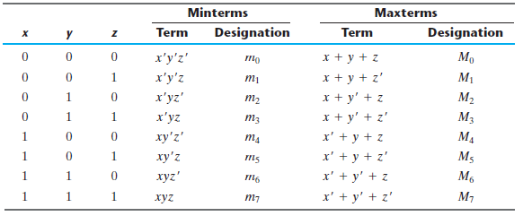
Min-terms and Max-terms for Three Binary Variables

Slide 11
Canonical form
A truth table consists of a set of inputs and outputs. If there are ‘n’ input variables, then there will be 2^{n} possible combinations with zeros and ones. So the value of each output variable depends on the combination of input variables. So, each output variable will have ‘1’ for some combination of input variables and ‘0’ for some other combination of input variables.
Therefore, we can express each output variable in following two ways.
Sum of minterms form
Product of maxterms form
Boolean functions expressed as a sum of minterms or product of maxterms are said to be in canonical form.

Slide 12
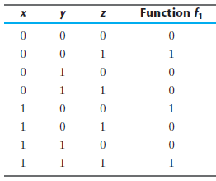
Sum of Minterms
A Boolean function can be expressed algebraically from a given truth table by forming a min-term for each combination of the variables that produces a 1 in the function and then taking the OR of all those terms.
f1 = x’ y’ z + x y’ z’ + x y z
= m1 + m4 + m7
= ∑(m1 , m4 , m7)
=∑m(1,4,7)

Slide 13
Example
Ex. Express the Boolean function F = A + B’ C as a sum of minterms.
Ans.
F = A + B ’ C =A(B+B’) + B’C(A + A’)
= AB + AB’ + AB’C + A’B’C
= AB(C + C’) + AB’(C + C’)+ AB’C + A’B’C
=ABC + ABC’ + AB’C + AB’C’ + AB’C + A’B’C
Combining all term
F = A’B’C+ AB’C’+AB’C+ABC’+ABC
= m₁+m₄+m₅+m₆+m₇
F(A, B, C) = ∑(1, 4, 5, 6, 7)
The summation symbol ∑ stands for the ORing of terms; the numbers following it are the indices of the minterms of the function. The letters in parentheses following F form a list of the variables in the order taken when the minterm is converted to an AND term.

Slide 14
Product of Maxterms
Now consider the complement of a Boolean function.
The complement of f₁ is
f₁’ = x’ y’ z’ + x’ y z’ + x’ y z + x y’ z + x y z’
If we take the complement of f₁ ’,
f₁ = (x + y + z)(x + y’ + z)(x + y’ + z’)(x’+ y +z’)(x ‘+ y’ + z)
= M₀ . M₂ . M₃ . M₅ . M₆
= ∏ (M₀ , M₂ , M₃ , M₅ , M₆)
= ∏ (0,2,3,5,6)
Form a maxterm for each combination of the variables that produces a 0 in the function, and then form the AND of all those maxterms.

Slide 15
Example
Ex. Express the Boolean function F= xy + x’z as a product of maxterms.
using distributive law→ F = xy + x’z =(xy+x’)(xy+z)
= (x + x’)(y + x’)(x + z)(y + z)
= (x’ + y)(x + z)(y + z)
Each OR term missing one variable
x’ + y = x’ + y + zz’ = (x’ + y + z)(x’ + y + z’)
x + z = x + z + yy’ = (x + y + z)(x + y’ + z)
y + z = y + z + xx’ = (x + y + z)(x’ + y + z)
Combining all the terms
F = (x + y + z)(x + y’ + z)(x’ + y + z)(x’ + y + z’)
= M₀M₂M₄M₅
F(x, y, z) = ∏(0, 2 , 4, 5)

Slide 16
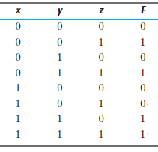
Conversion between canonical forms
Ex. Boolean expression: F = xy + x’z
xy = 11 or xz = 01
sum of minterms is
F(x, y, z) = ∑(1, 3, 6, 7)
product of maxterms is
F(x, y, z) = ∏(0, 2, 4, 5)
Take complement of F’ by DeMorgan’s
theorem
To convert from one canonical form to another, interchange the symbols ∑ and ∏ and list those numbers missing from the original form.

Slide 17
Standard SOP and POS forms
We discussed two canonical forms of representing the Boolean outputs.
Another way to express Boolean functions is in standard form. In this configuration, the terms that form the function may contain one, two, or any number of literals. There are two types of standard forms: the sum of products and products of sums.

Slide 18
Standard SOP form
Standard SOP form means Standard Sum of Products form. In this form, each product term need not contain all literals. So, the product terms may or may not be the minterms.
The sum of products is a Boolean expression containing AND terms, called product terms, with one or more literals each. The sum denotes the ORing of these terms. An example of a function expressed as a sum of products is
F1 = y + xy + xy’z
The expression has three product terms, with one, two, and three literals. Their sum is, in effect, an OR operation.

Slide 19
Standard POS form
Standard POS form means Standard Product of Sums form.
A product of sums is a Boolean expression containing OR terms, called sum terms.
Each term may have any number of literals. The product denotes the ANDing of these terms.

Slide 20
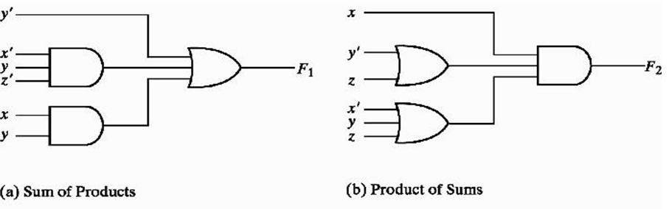
Three‐ and two‐level implementation of Standard forms
Another way to express Boolean functions is in standard form.
Sum of products(SOP): F₁ = y’ + xy + x’yz’
Product of sums(POS): F₂ = x(y’ + z)(x’ + y + z’)

Slide 21
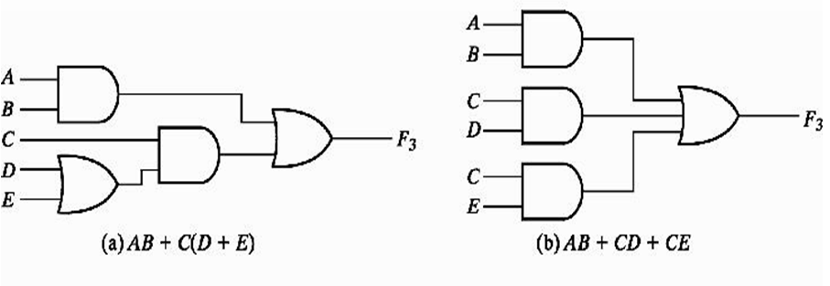
Standard forms
F₃ is a non-standard form, neither in SOP nor in POS.
F₃ can change to a standard form by using distributive law.

Slide 22
HDL Description of Boolean Function
Write HDL Description of the function
F=AB+CD+CE
// Verilog model: Circuit with Boolean expressions
module Circuit_CA ( F, A, B, C,D,E);
output F;
input A, B, C, D, E;
assign F = (A && B) || (C && D) || (C && E) ;
endmodule

Slide 23
HDL Description of Boolean Function
Write HDL Description of the function
F=AB+C(D+E)
// Verilog model: Circuit with Boolean expressions
module Circuit_CA ( F, A, B, C, D, E);
output F;
input A, B, C, D, E;
assign F = (A && B) || (C && (D || E)) ;
endmodule

